Slide 1
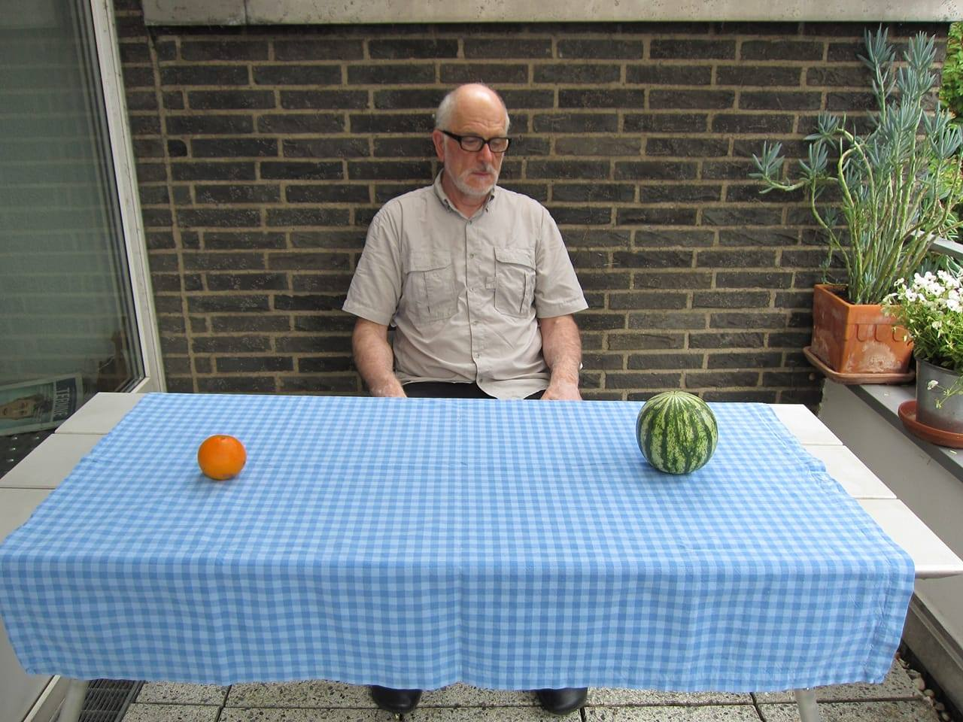
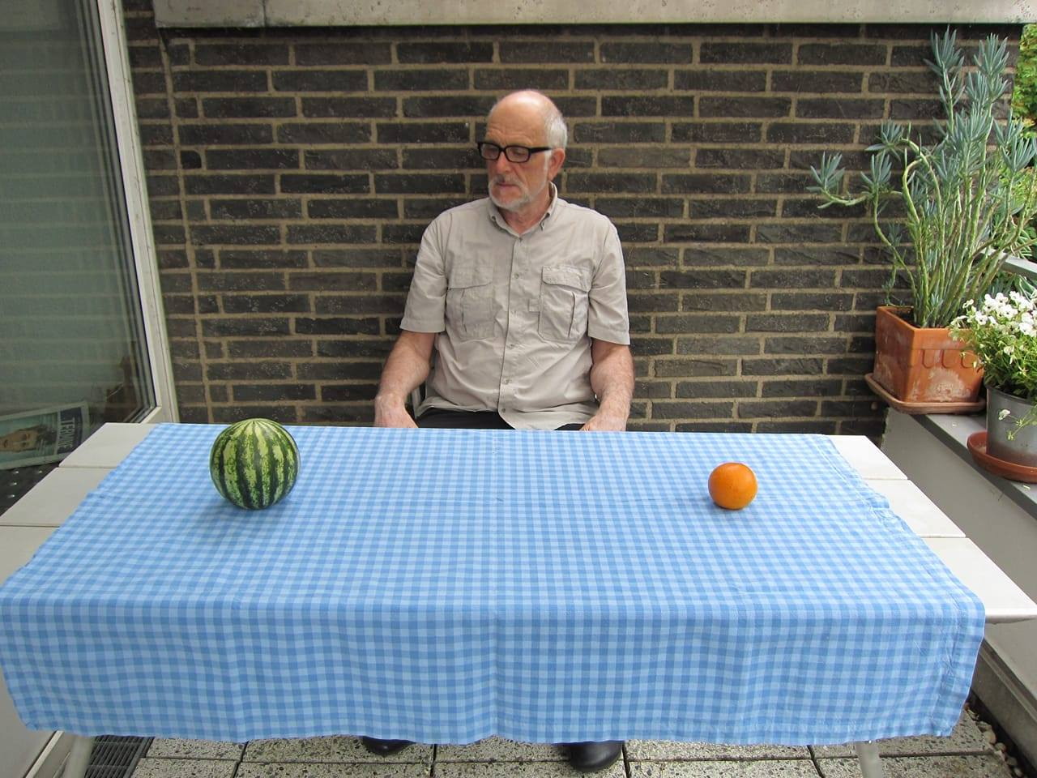
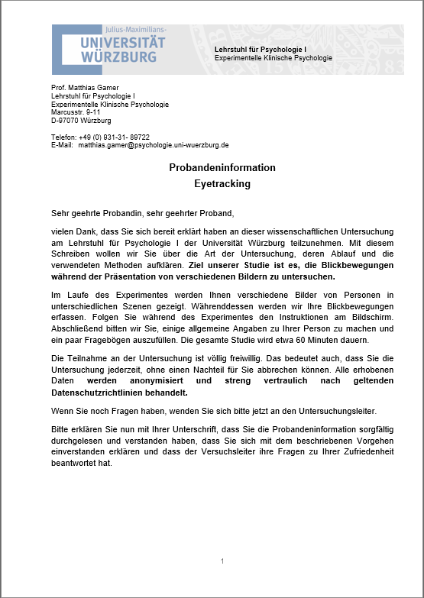
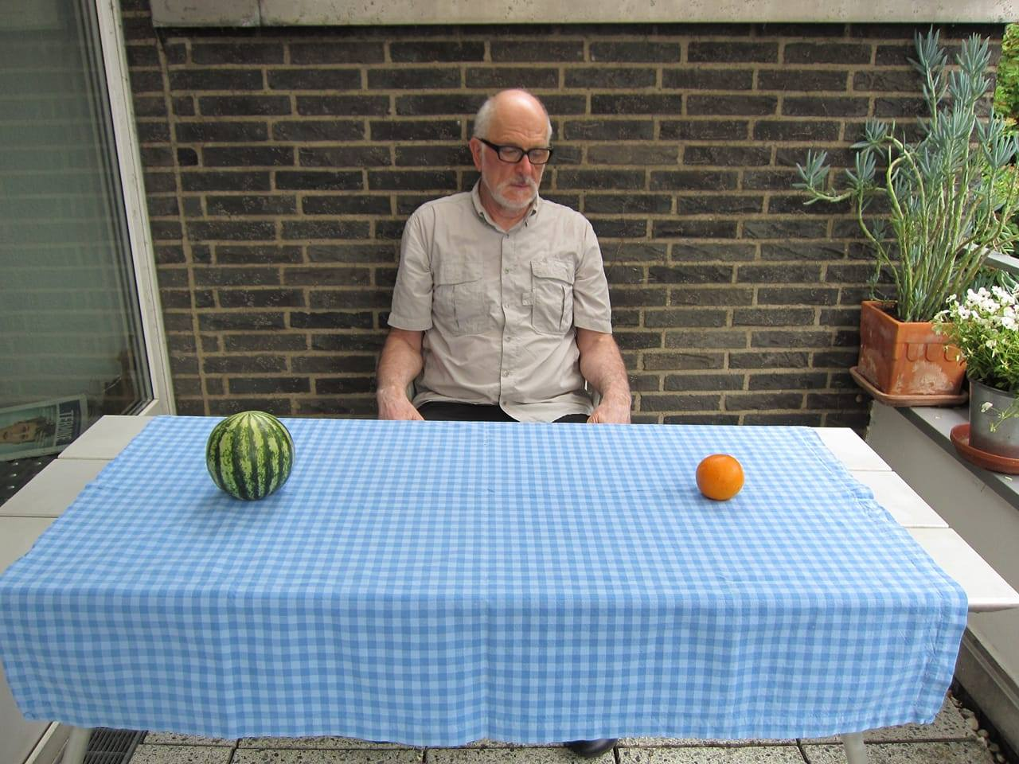
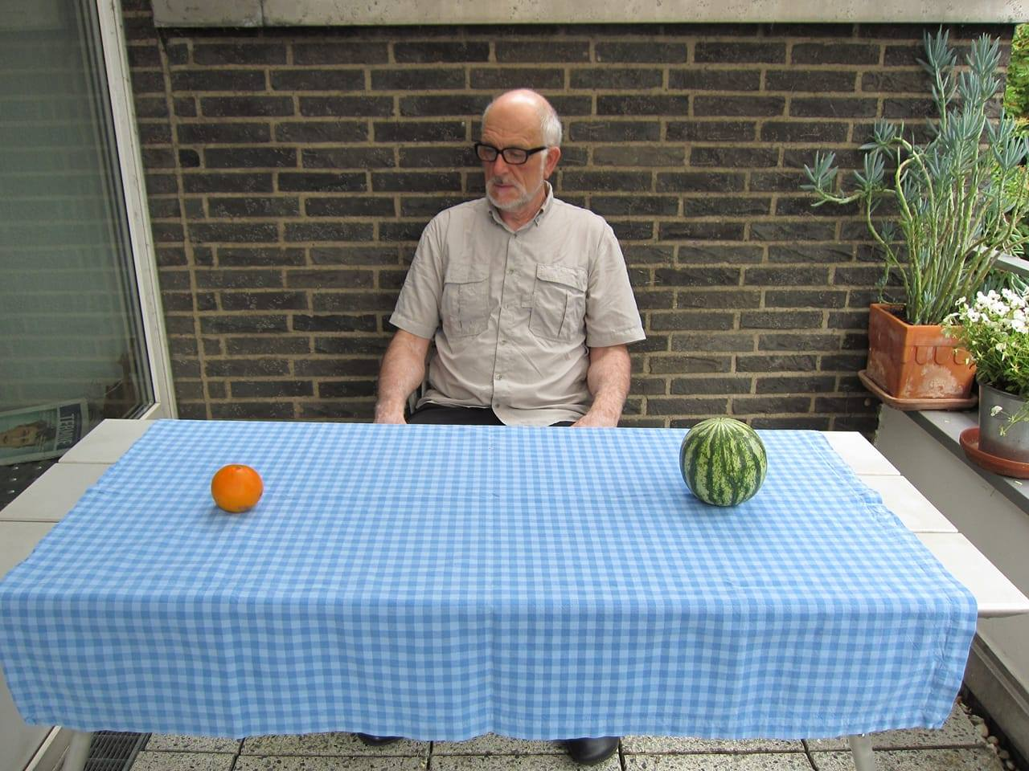
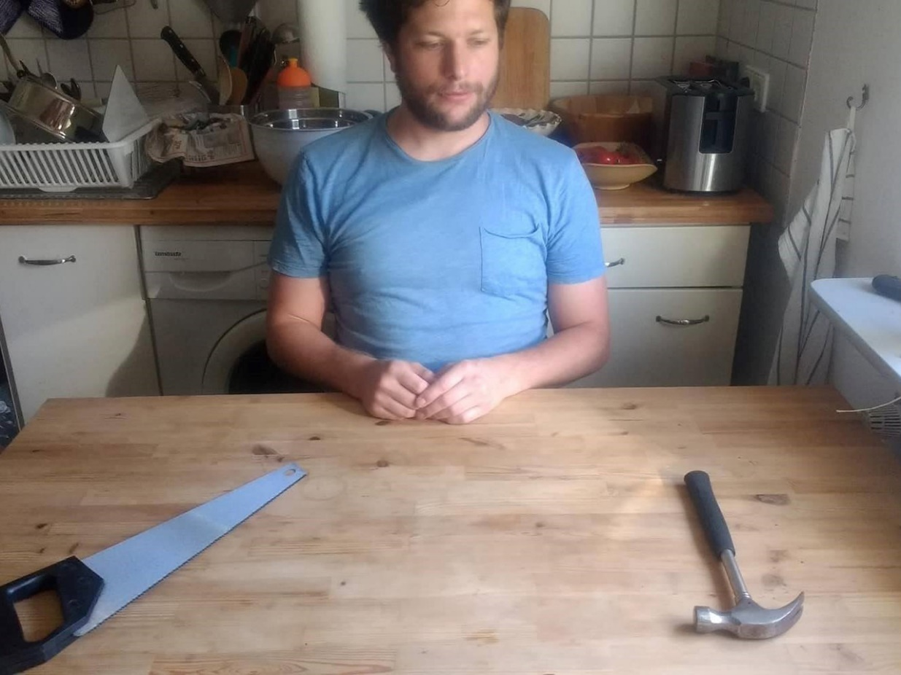

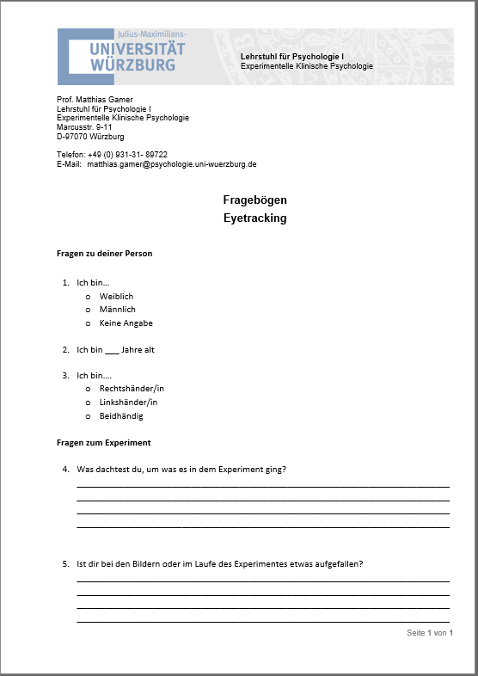
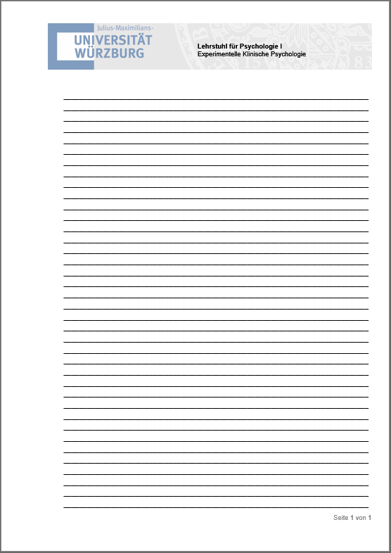
26 sets, 104 unique scenes
Manipulating groups
explicit encoding
„Take a good look at the pictures. At the end of the experiment, you have to recall as many objects as possible.”
free viewing
„Take a good look at the pictures.”
Eye tracking trials
+
Hand drawn ROIs
10 seconds 2 – 4 seconds 10 seconds
not gazed-at object
gazed-at object
Questionnaire
Free recall test
Free recall test:
„Please recall as many items as possible.”

Slide 2
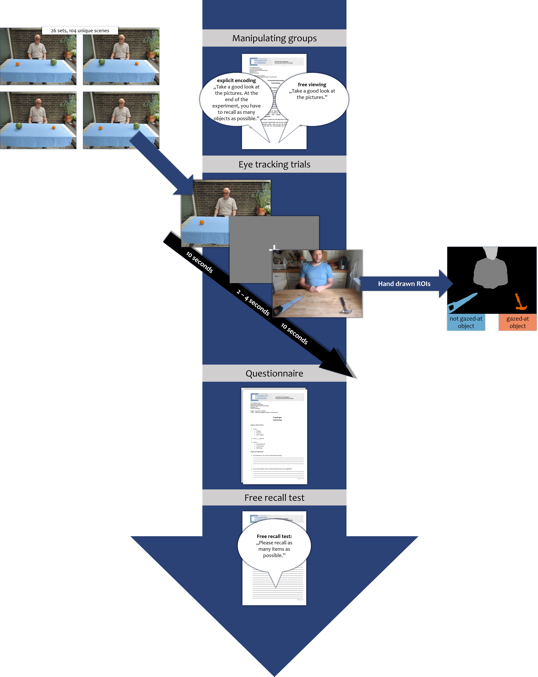
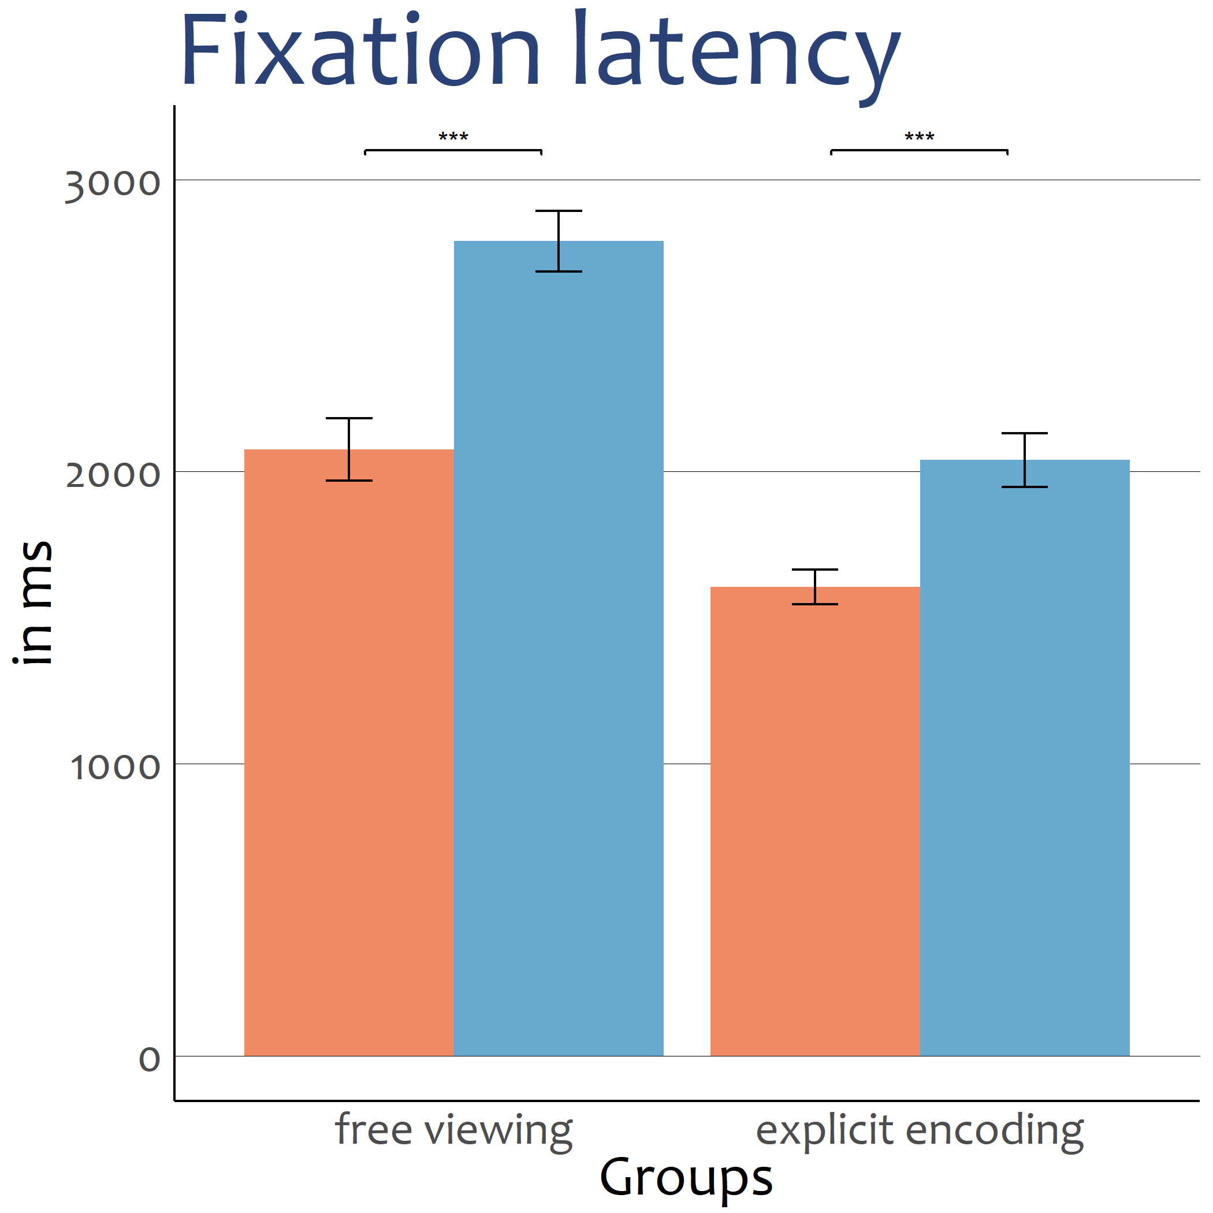
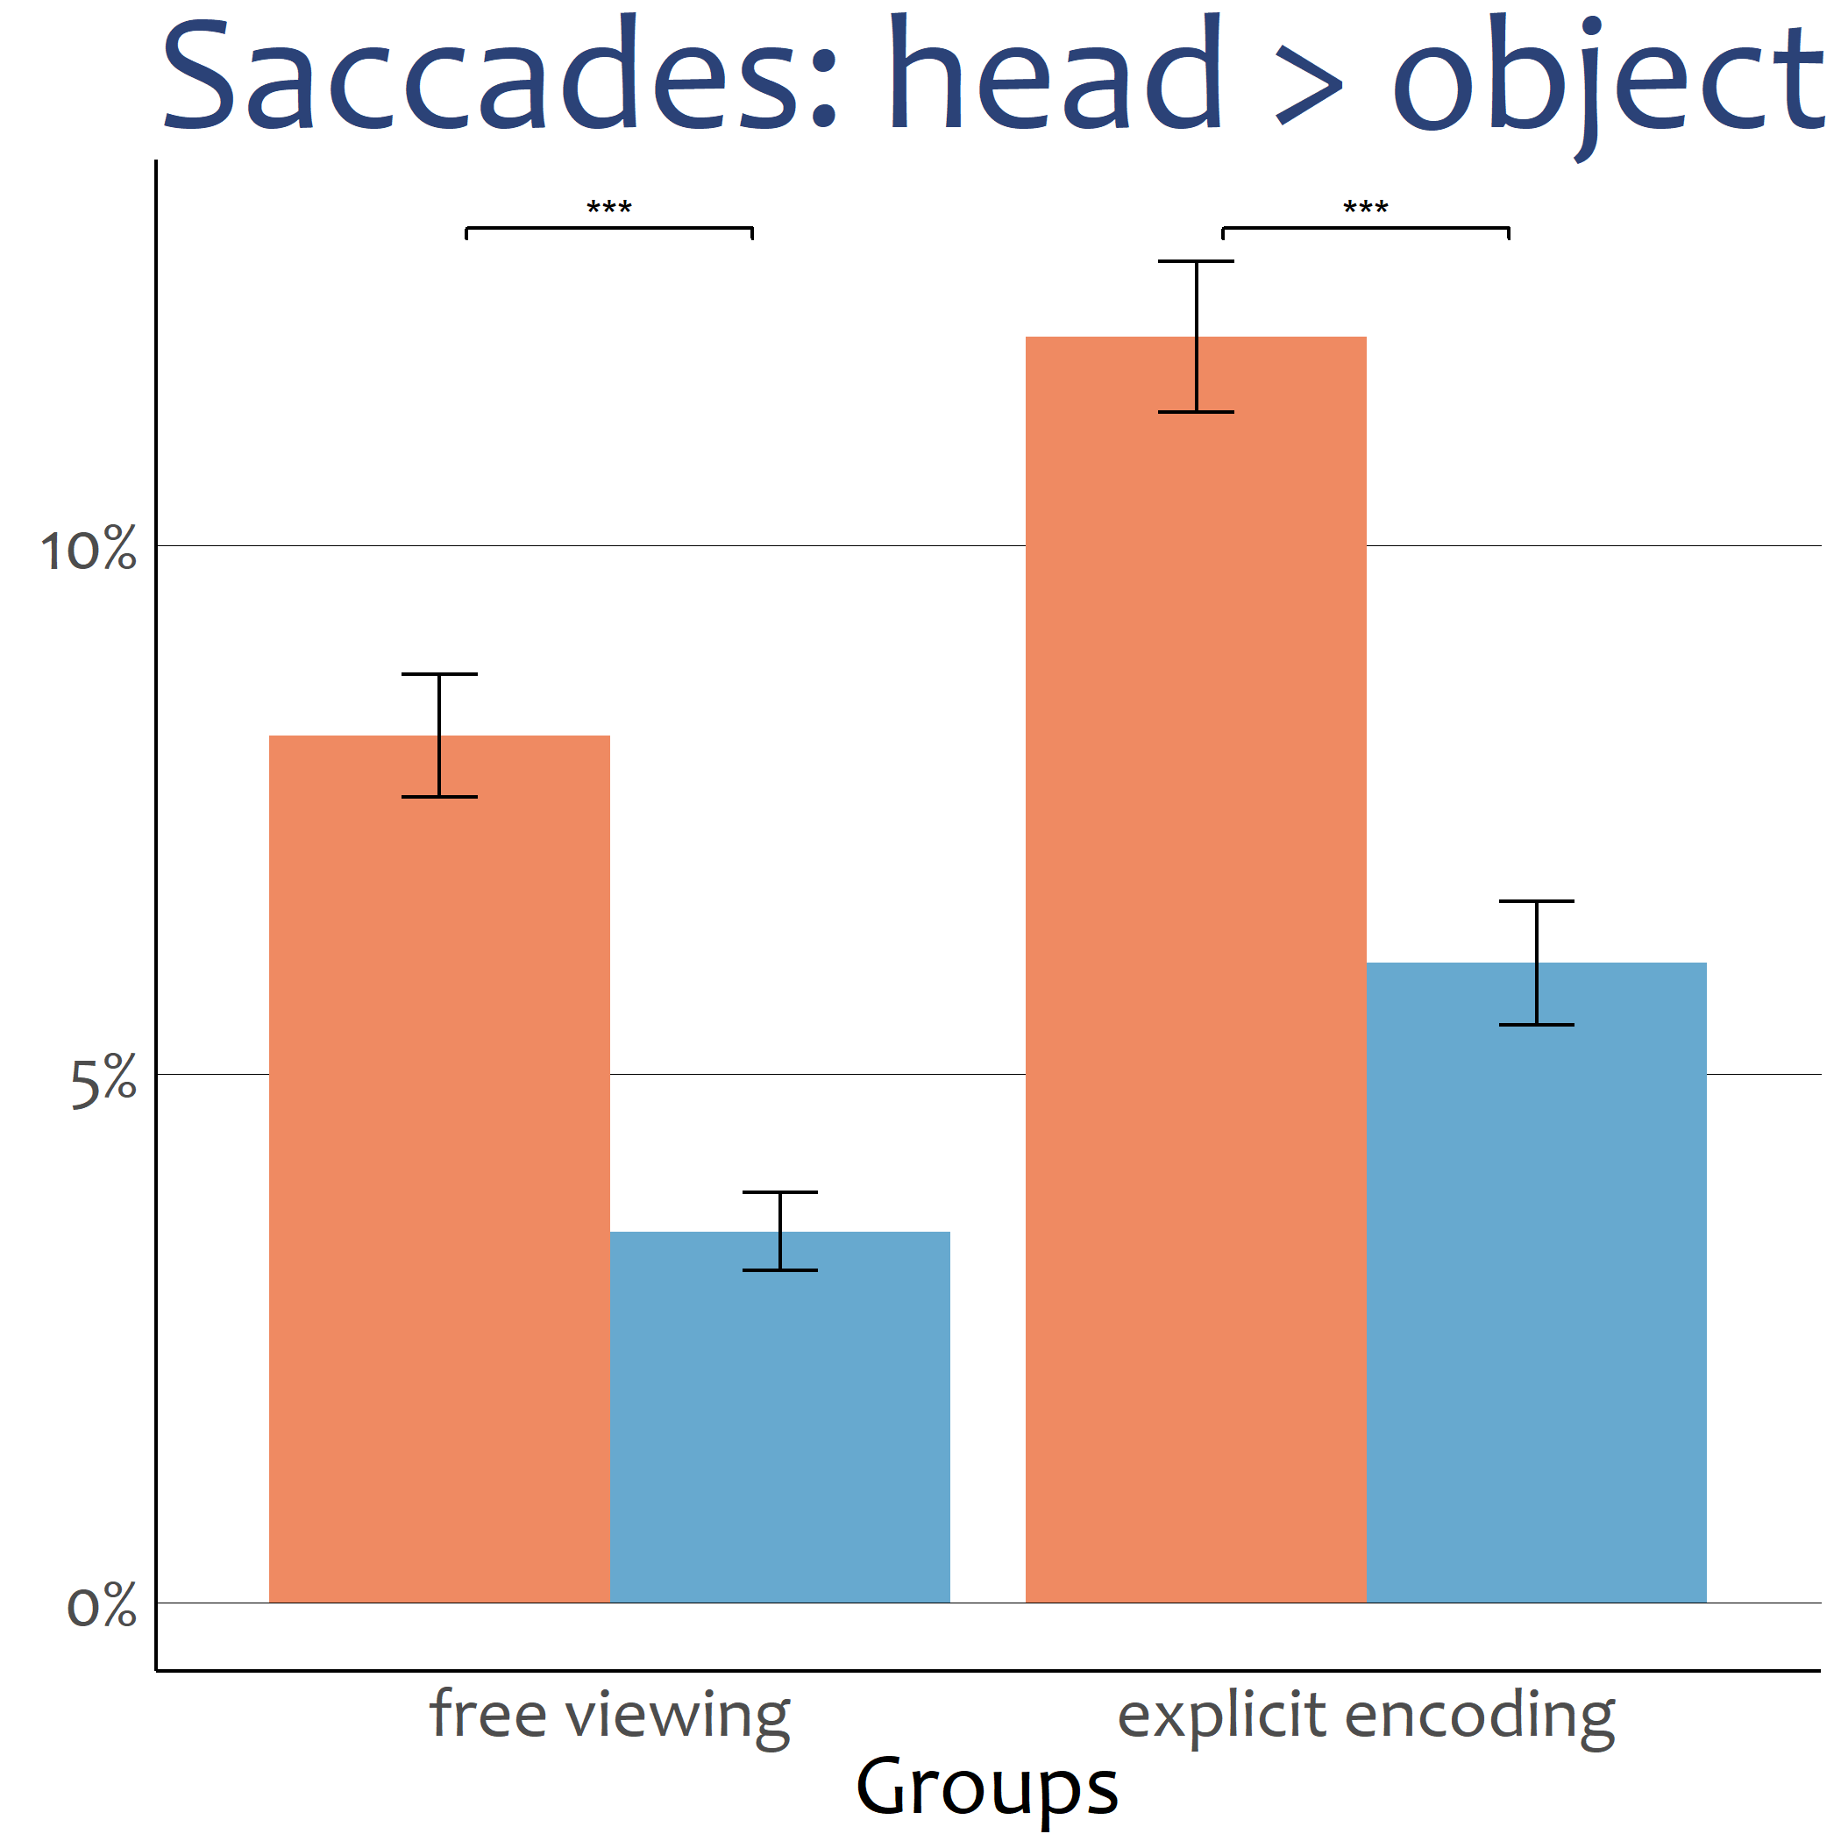
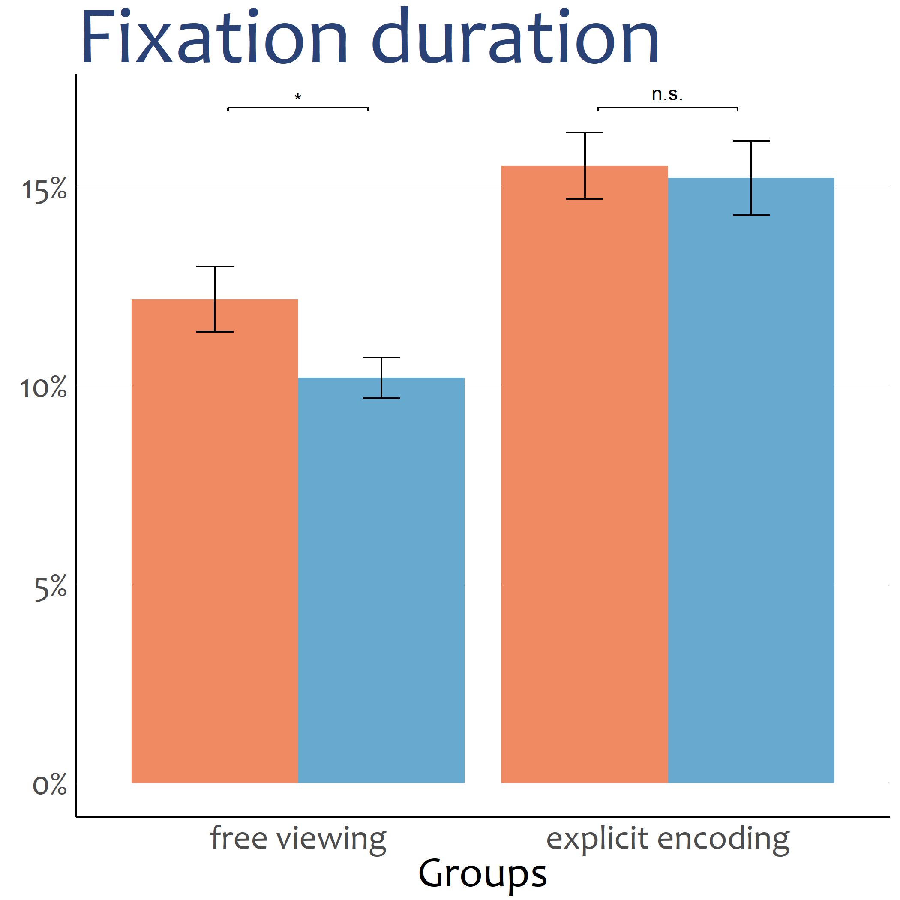
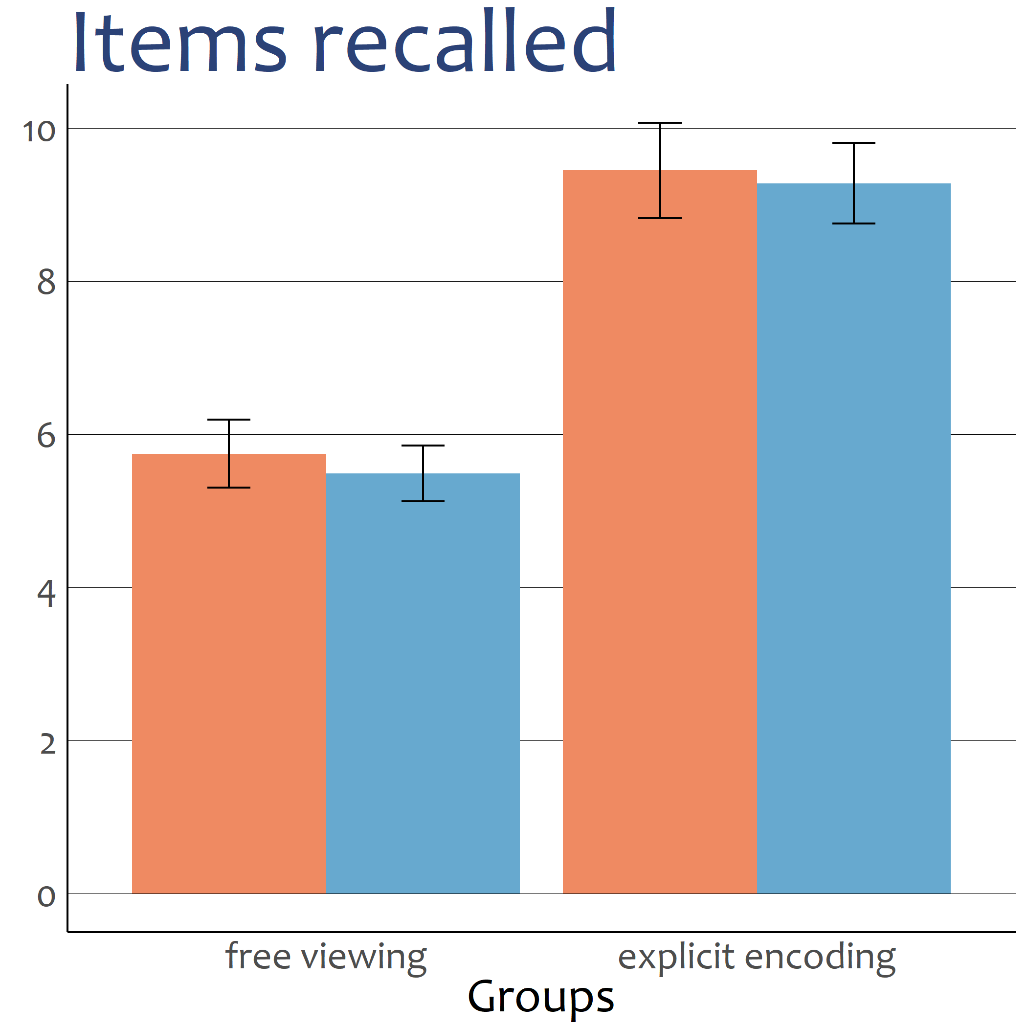

Gaze cueing in naturalistic scenes under top-down modulation
A conceptual replication
Jonas D. Großekathöfer,
Kristina Suchotzki &
Matthias Gamer
Introduction
Humans in their social environment rely on the information conspecifics provide. One important signal in social communication is eye gaze¹.
Specifically, if an individual looks into a certain direction, this information is often read spontaneously by an observer and redirects his or her own attention towards the referred object or location². Such guidance of someone else’s attention can be called gaze cueing.
The current study sought to replicate and extend Zwickel & Võ’s findings of attentional guidance by mere presences of a person in complex everyday scenes³.
Additionally we investigated how robust different prioritization measures are against top-down modulation. By introducing a memory test an explicit and systematic encoding of the scene was induced, which potentially interferes with gaze cueing effects.
Hypotheses
H1 Prioritization of gazed-at objects results in
smaller fixation latency
longer fixation duration
more saccades leaving the head towards the object
H2 Prioritization of the gazed-at object is weaker in the explicit encoding group.
H3 Better recall performance in the explicit encoding group
Better recall performance for gazed-at objects especially in the free viewing group
Methods
Participants. N = 94, 65 female, M_{age} = 24.73 years, SD_{age} = 5.04 years
Design. 2 x 2 mixed free-viewing design,
between factor: group membership
free viewing vs. explicit encoding
within factor: object role
gazed-at object vs. not gazed-at object
Results
effect for object role: ***
effect for group: ***
Interaction: p = .07
effect for object role: ***
effect for group: ***
Interaction: p = .24
effect for object role: **
effect for group: ***
Interaction: p = .12
effect for object role: p = .52
effect for group: ***
Interaction: p = .88
Discussion
We replicated Zwickel and Võ’s results, that a person affects attentional allocation, even when the person is not made prominent by the task³.
Additionally, we found evidence that even when the person is made irrelevant by a task, gaze cueing was evident in all measurements.
Against prediction, group membership did not interact with object role (interestingly
latency, as an early measure of attentional allocation showed a trend for an interaction). Attentional guidance by gaze cueing can be seen even when observers investigate the scene more systematically. This highlights the reflexive nature of social attention that seems to resist top down modulation. (even during explicit encoding of the scene).
All in all, our study underlines the reflexivness of gaze cueing, even under top-down modulation. ⁴ Humans have to interact with each other, even on a photography.
References:
¹ Emery, N. J. (2000). The eyes have it: the neuroethology, function and evolution of social gaze. Neurosci Biobehav Rev, 24(6).
² Frischen, A., Bayliss, A. P., & Tipper, S. P. (2007). Gaze cueing of attention: visual attention, social cognition, and individual differences. Psychol bull, 133(4).
³ Zwickel, J., & Võ, M. L. H. (2010). How the presence of persons biases eye movements. Psychol Bull Rev, 17(2).
⁴ Ristic, J., & Kingstone, A. (2005). Taking control of reflexive social attention. Cogn, 94(3).
Contact:
Mail: jonas.grossekathoefer@uni-wuerzburg.de
Twitter: @JonasGrszkthfr

